Slide 1















Project presentation
YT Sprint
by
Mohd Abdul Aleem (1604-21-733-110)
Mohammed Fasiuddin (1604-21-733-109)
Mohammed Amaanuddin (1604-21-733-108)

Slide 2

Introduction
The Digital Age and Video Content: The digital age has led to an explosion of video content online, with YouTube being one of the largest platforms. Every minute, over 500 hours of video are uploaded, creating a massive repository of information.
Challenges for Users: Despite the abundance of content, finding relevant and digestible information has become increasingly difficult. Traditional search and browsing methods are time-consuming and often ineffective, leading to frustration among users.
Objective of the Project: YT Sprint aims to address this issue by utilizing Natural Language Processing (NLP) to create concise summaries of YouTube videos, allowing users to quickly grasp the main ideas without watching entire videos.

Slide 3
Navigating Vast Video Content:
With over 500 hours of video uploaded to YouTube every minute, the platform is inundated with content. This sheer volume makes it extremely challenging for users to sift through and find valuable information. The traditional search and browse functions often fall short, leaving users overwhelmed and unable to efficiently locate the content they need.
01.
Problem Statement
Time-Consuming Process:
Watching lengthy videos to extract key information can be incredibly time-consuming. Professionals, students, and casual users alike often need to watch entire videos just to gather a few relevant points. This inefficient process not only consumes valuable time but also detracts from productivity and learning experiences.
02.
In today's digital era, YouTube has become a colossal repository of video content, catering to diverse audiences worldwide. However, the platform's immense popularity and continuous influx of uploads pose significant challenges for users trying to efficiently consume and extract valuable information. These challenges are compounded by several critical issues that hinder the overall user experience.
Inconsistent Quality and Relevance:
Not all videos are created equal; the quality and relevance of content can vary significantly. Users frequently encounter videos with misleading titles, irrelevant content, or low-quality production. This inconsistency hinders the ability to quickly assess the value of a video, leading to wasted time and frustration.
03.

Slide 4
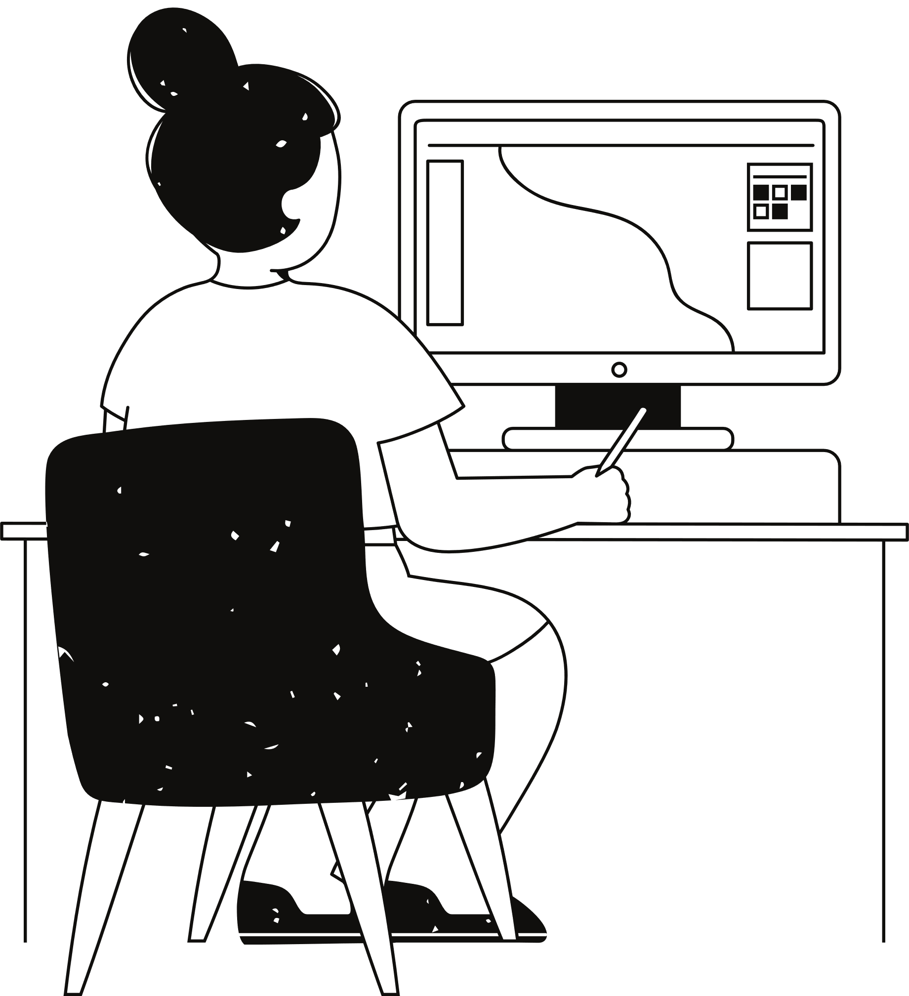
Existing System
Traditional Video Summarization Techniques: Many existing systems use extractive summarization techniques, which involve selecting key sentences from transcripts. These methods, while useful, often fail to capture the full context and meaning of the video content.
Limitations of Current Methods: The current summarization techniques are often too simplistic and do not provide coherent summaries that are easy to understand. Additionally, they may not perform well across different types of content or languages.
User Experience Challenges: The existing systems often require users to manually select content for summarization, which can be cumbersome and time-consuming.

Slide 5
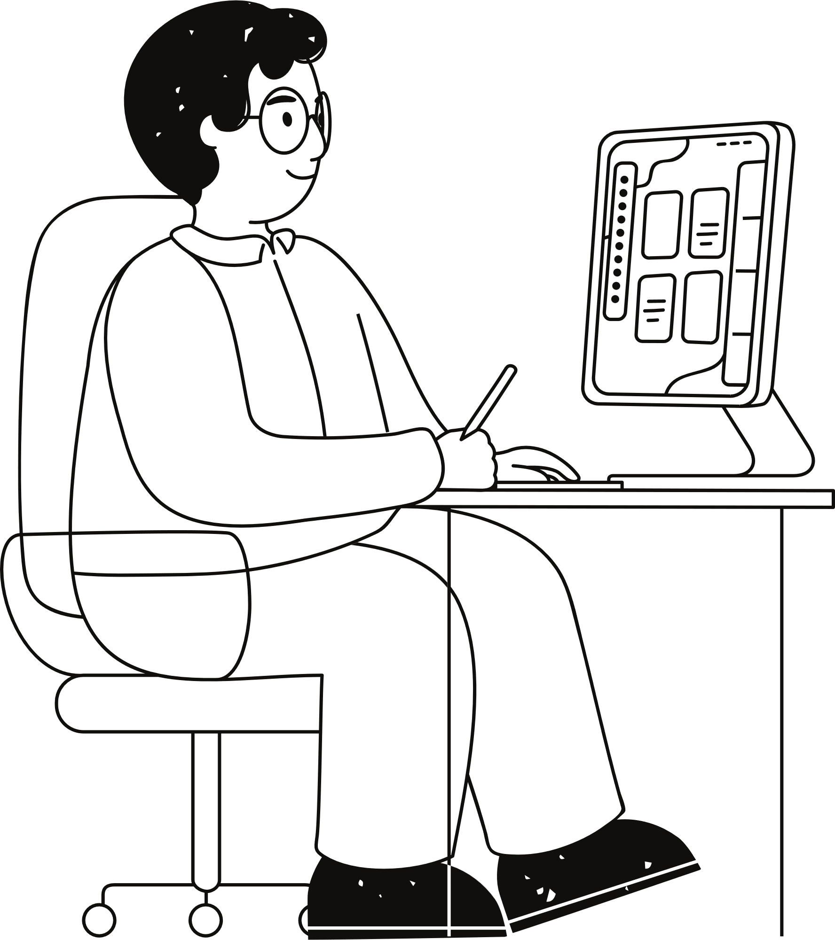
Related Research
State-of-the-Art NLP Techniques: Recent advances in NLP, such as transformer models (e.g., BERT, GPT), have significantly improved the ability to generate more coherent and contextually accurate summaries. These models are capable of understanding context and generating human-like text.
Video Summarization in Industry: Companies like Google and Microsoft have developed their own video summarization tools, but these are typically integrated into larger platforms and may not be easily accessible or customizable for specific needs.
Gaps in Current Research: Despite advancements, there remains a gap in effectively summarizing video content in a way that balances comprehensiveness with brevity. Additionally, there is a need for more accessible tools that can be used by a wide range of users.

Slide 6

Proposed System Architecture
Overview of Architecture: The proposed system architecture for YT Sprint integrates both extractive and abstractive summarization techniques. It consists of several key components:
Input Layer: Users input a YouTube video URL or upload a video file.
Preprocessing Layer: The video transcript is extracted and preprocessed using tokenization, stop-word removal, and other NLP techniques.
Summarization Layer: The system applies a combined approach of extractive summarization (using Latent Semantic Analysis) and abstractive summarization (using transformer models) to generate summaries.
Output Layer: The summary is displayed to the user in a concise, easy-to-read format.
Integration: The system is designed to be scalable and can be integrated into existing platforms or used as a standalone application.

Slide 7

Flowchart
User Input
Start
Fetch Transcript
Preprocessing
Is Transcript Clean?
No
Yes
Summarization
Output Summary
Stop

Slide 8
Algorithm of the Proposed System
Extractive Summarization (LSA):
Latent Semantic Analysis (LSA): LSA is used to identify and extract the most important sentences from the video transcript. It works by analyzing the relationships between words and sentences, creating a matrix that highlights the most relevant content.
Abstractive Summarization (Transformer Models):
Transformer Models (e.g., BERT, GPT): These models are trained on vast amounts of text data to understand context and generate new, coherent sentences that summarize the content. Unlike extractive methods, transformer models can create summaries that are more fluent and human-like.
Combined Approach: The system leverages both techniques to ensure that the summary is both comprehensive and easy to understand.

Slide 9


Explanation of the Proposed System
NLP Integration: The proposed system effectively integrates NLP techniques to produce high-quality summaries. The extractive component ensures that key points are not missed, while the abstractive component enhances readability and fluency.
User-Centric Design: The system is designed with the user in mind, offering customizable summary lengths and allowing users to focus on the most relevant content.
Scalability and Flexibility: The system can handle a wide range of video content, regardless of language or complexity, making it a versatile tool for various applications.

Slide 10

Metrics Used
Accuracy: The system's ability to correctly identify and summarize the main points of a video.
Fluency: How well the generated summary reads, in terms of grammar and coherence.
Time Efficiency: The speed at which the system can generate a summary, particularly for longer videos.
User Satisfaction: Feedback from users regarding the usability and effectiveness of the summaries

Slide 11
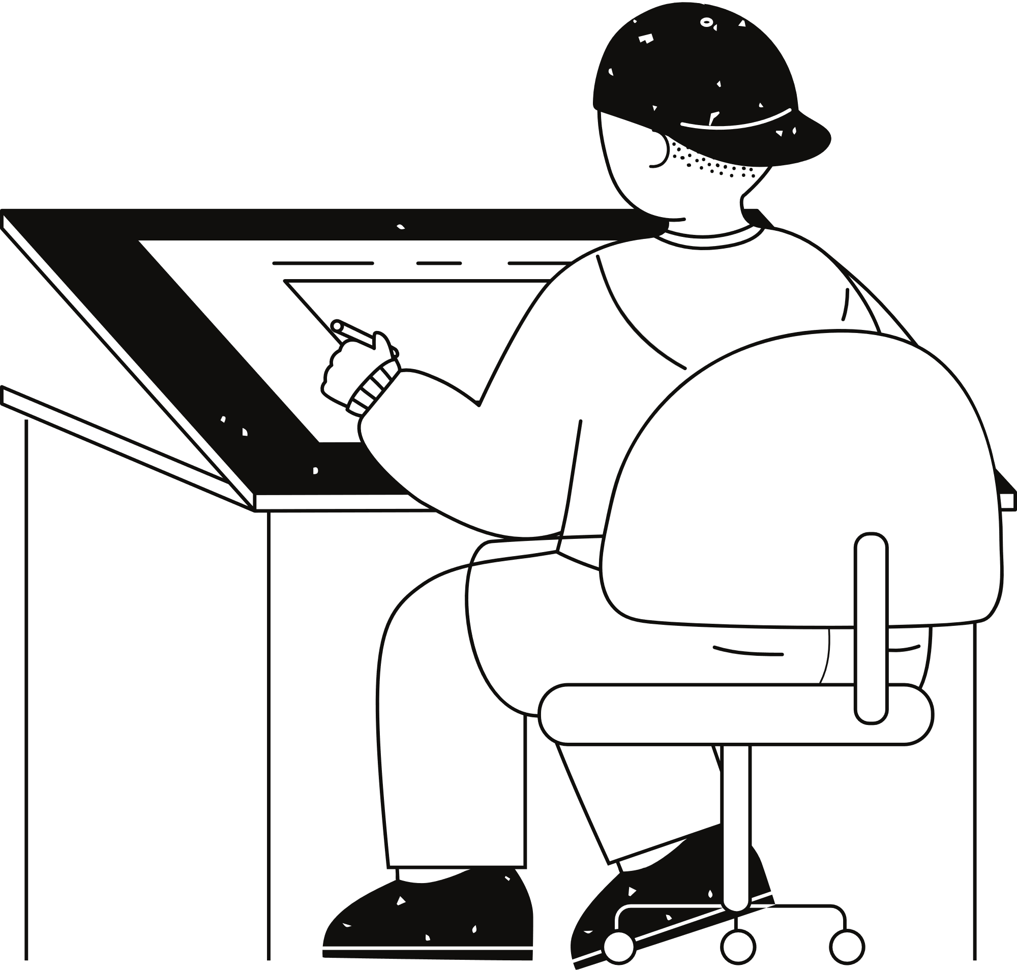




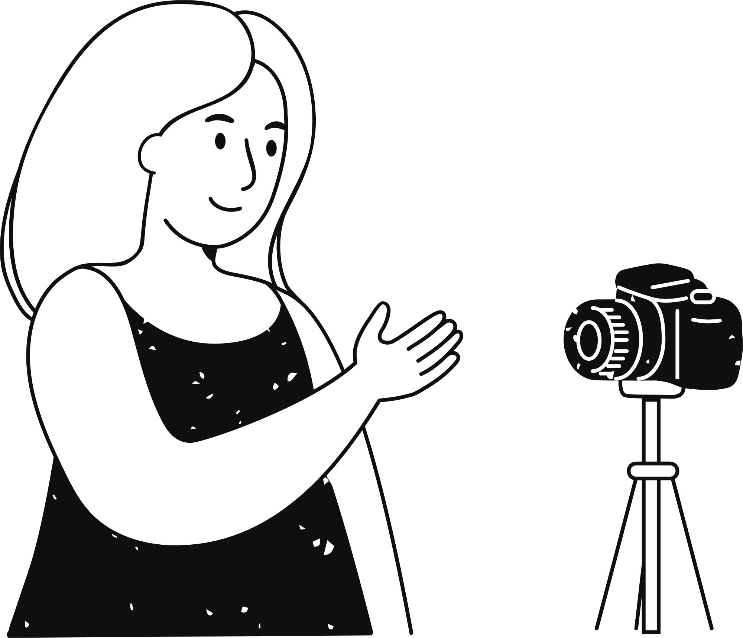
Improve Content Discovery
- Automatically generate summaries for users to browse and find relevant videos
Save Time
- Quickly grasp the main points of a video without watching the entire content
Increase Accessibility
- Help visually or hearing-impaired users understand video content through text summaries
Enhance User Experience
- Provide an engaging and concise way to consume video content
Benefits
Exploring advantages
Unlock Insights
- Analyze video content at scale, uncovering valuable trends and patterns
Boost Productivity
- Automate the summarization process, saving manual effort and time

Slide 12
Results Comparison
Metric | Existing System | YT Sprint (Proposed System)
Accuracy | Moderate accuracy due to reliance on simple extractive methods. | High accuracy due to advanced NLP techniques combining extractive and abstractive summarization.
Fluency | Often lacks coherence, as extractive methods do not generate new sentences. | High fluency, with coherent and human-like summaries generated by transformer models.
Time Efficiency | Faster for shorter videos but struggles with longer content. | Optimized for both short and long videos with efficient processing time.
User Satisfaction | Moderate satisfaction due to basic summaries. | High satisfaction due to comprehensive and readable summaries that capture essential content

Slide 13
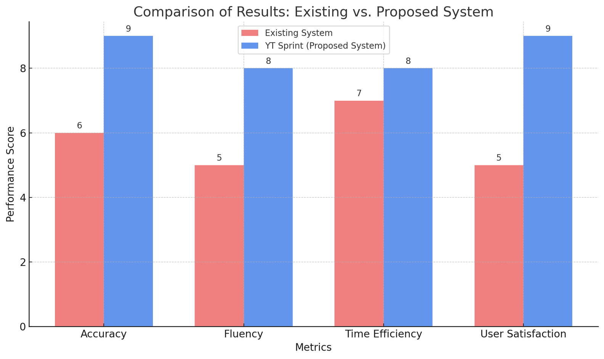
Barchart

Slide 14

Future Work and Potential Enhancements
Expanding Language Support: Future work will focus on improving language support, allowing the system to summarize videos in multiple languages.
Enhancing Summarization Models: Ongoing research will aim to refine the transformer models used in the system, improving their ability to understand context and generate even more accurate summaries.
Real-World Applications: The team plans to collaborate with industry partners to deploy the technology in various sectors, including education, marketing, and entertainment, where quick and efficient content summarization is crucial.
User Feedback Integration: Continuous improvement of the system will be driven by user feedback, ensuring that the summaries meet the evolving needs of the audience.

Slide 15
Thank you very much!
YT Sprint

